Slide 1

Question Answering
Neural Reasoning Model for

Slide 2
Introduction

Slide 3

Why do we need Question Answering(QA) systems?
QA systems are capable of providing specific answers for questions so that users are saved the hassle of going through several sources to form one.
These systems have applications ranging from healthcare to advertising. But it is still an evolving technology.

Slide 4
What are the issues with existing QA Systems?
The major issues are in how the system understands the question and how it reasons to provide an accurate answer when it is presented with a complex query.

Slide 5
How is your system going to improve on the solutions already provided by existing QA systems?
The proposed system will improve Reasoning, Attention and Memory in Deep Neural Networks by using a Reinforced Memory Network ^{[1]} which is the current state of art.
[1] Anupiya Nugaliyadde, Kok Wai Wong, Ferdous Sohe and Hong Xie, "Reinforced Memory Network for Question Answering". Available: https://www.researchgate.net/publication/320658588_Reinforced_Memory_Network_for_Question_Answering

Slide 6
Existing systems

Slide 7
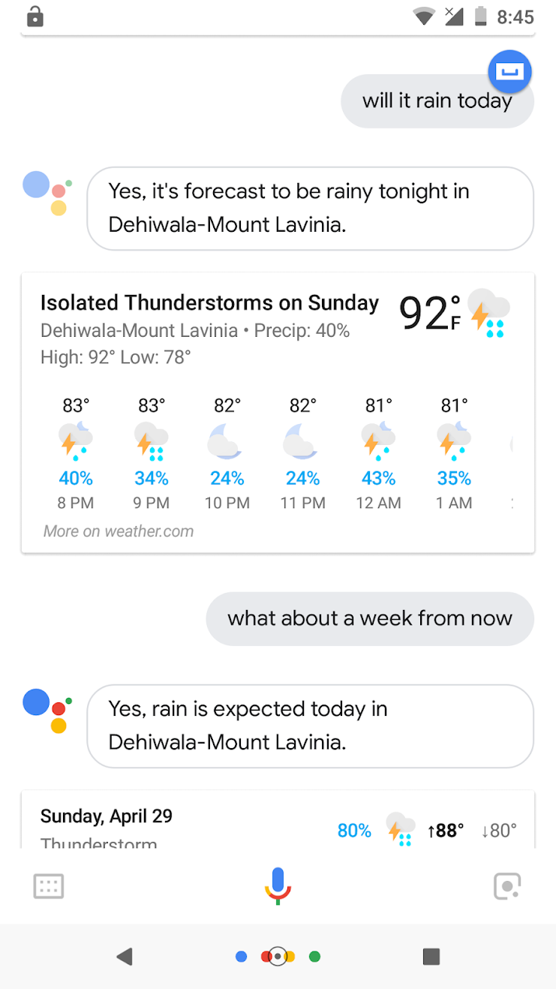

Google Assistant

Slide 8
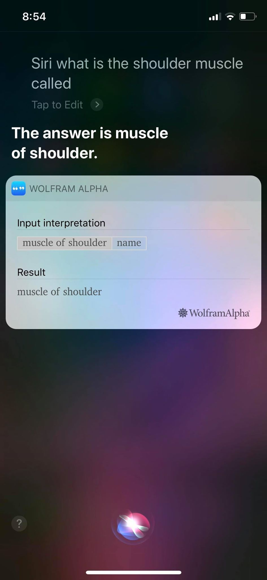

Siri

Slide 9
Objectives

Slide 10

Main Objective
Build a Question Answering System, leveraging optimized Deep Learning techniques by combining Reasoning, Attention and Memory (RAM model) Mechanisms to assess the system in a real context.

Slide 11





Specific Objectives
Improvements in interpreting the questions in natural language to a machine-understandable form
Improvements in Reasoning in the deep neural network to support RAM model
Improvements in Attention to focus on only relevant parts of the input to support RAM model
Answer is extracted and presented to the user preserving the syntactic features of the original question
Improvements in Memory in the deep neural network to support RAM model

Slide 12
Methodology
Methodology

Slide 13

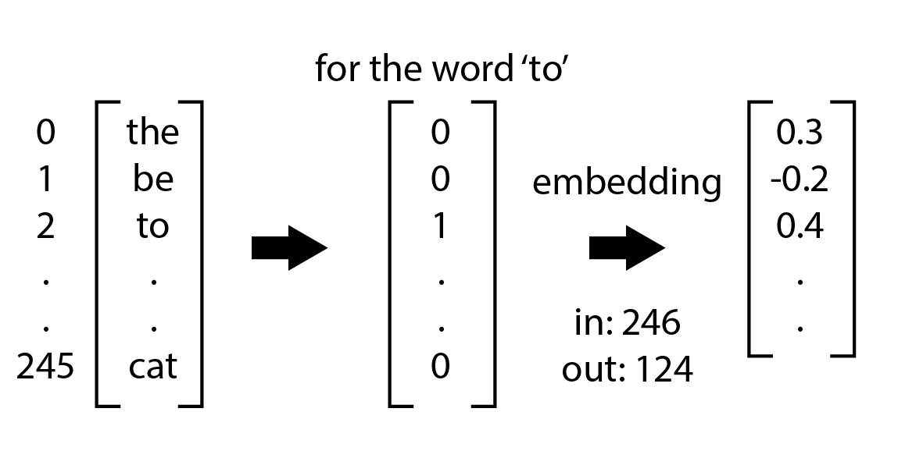
Improvement of Pre-Processing
Representing the meaning of words through numerically(Vector) that capture semantic and syntactic information of words.

Slide 14
Researches done on Question Processing
Using multiple word prototypes instead of a single vector combining both local and global context. (in addressing homonymy and polysemy)
Using Arbitrary contexts to form a vocabulary instead of the commonly used linear bag-of-words contexts.
[1] Huang, E., Socher, R., Manning, C. and Ng, A. (2012). Improving word representations via global context and multiple word prototypes. [online] https://dl.acm.org. Available at: https://dl.acm.org/citation.cfm?id=2390645 [Accessed 22 Apr. 2018].
[2] Levy, O. and Goldberg, Y. (2018). Dependency-Based Word Embeddings. [online] Aclweb.org. Available at: http://www.aclweb.org/anthology/P14-2050 [Accessed 22 Apr. 2018].

Slide 15
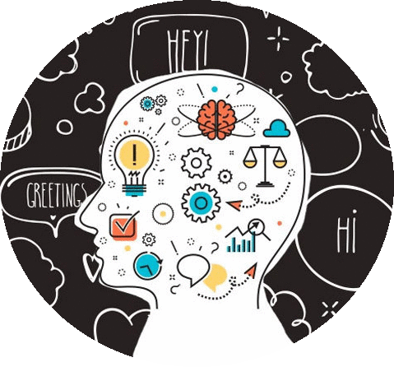
Improvement of Attention
Why attention in QAS ?
One of the main problems Recurrent Neural Networks facing is fixed length vector issue
All input sequences are forced to be encoded to a fixed length internal vector.
Input question and context both.
Notes:
DMN
Mary moved to the bathroom. John went to the hallway. Where is Mary? bAbI dataset

Slide 16
Improvement of Attention
What is attention in QAS ?
Attention is the mechanism which is used in Encoder Decoder model that identifies which parts of the input sequence are relevant to predict output, whereas prediction is the process of using the relevant information to select the appropriate output.
E.g.:
Mary went to bathroom. Jack went to hallway. Where is Mary?
-bAbl dataset
Notes:
DMN
Mary moved to the bathroom. John went to the hallway. Where is Mary? bAbI dataset

Slide 17
Researches done on improving Attention
GLOBAL-LOCAL ATTENTION
Learning to align in machine translation
[1]D. Bahdanau, K. Cho and Y. Bengio, "NEURAL MACHINE TRANSLATION BY JOINTLY LEARNING TO ALIGN AND TRANSLATE", 2014. [Online]. Available: https://arxiv.org/pdf/1409.0473.pdf.
[2]Y. Bachrach, A. Zukov-Gregori ˇ c, S. Coope, E. Tovell, B. Maksak, J. Rodriguez, C. McMurtie and M. Bordbar, Arxiv.org, 2017. [Online]. Available: https://arxiv.org/pdf/1707.01378.pdf.

Slide 18
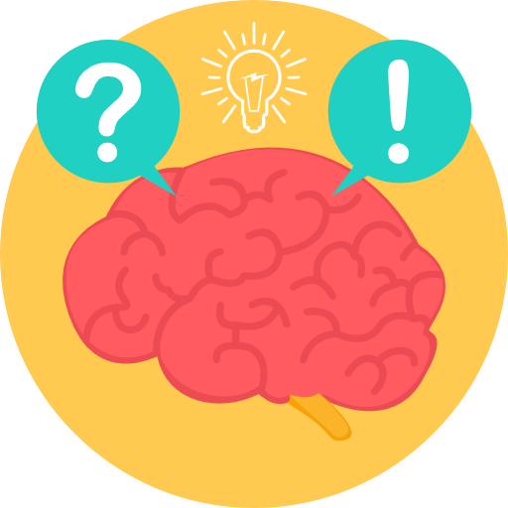
Improvement of Reasoning
Reasoning is the ability to reason about entities and relationships intuitively.
E.g.:
In the afternoon Julie went to the park. Yesterday Julie was at school. Julie went to the cinema this evening. Where did Julie go after the park?
-bAbl dataset

Slide 19
Researches done on Reasoning
Reasoning is what Knowledge bases and Ontology approaches lacked.
Previous efforts on reasoning in Neural Networks were rule based. ^{[1]}
State of art systems use pure neural networks for Reasoning. ^{[1]}
[1] B. Peng, Z. Lu, H. Li and K. Wong, "Towards Neural Network-based Reasoning". Available: http://www.thespermwhale.com/jaseweston/ram/papers/paper_18.pdf
[2] Gabriel Recchia, “Considerations for Evaluating Models of Language Understanding and Reasoning”. Available: http://www.thespermwhale.com/jaseweston/ram/papers/paper_14.pdf

Slide 20
Researches done on Reasoning
Reasoning capabilities depend on the usage of long term and short term dependencies during inference.
This system will use Reinforced Memory Networks which is a combination of Memory Networks and Reinforcement Learning^{[1]}
[1] Anupiya Nugaliyadde, Kok Wai Wong, Ferdous Sohe and Hong Xie, "Reinforced Memory Network for Question Answering". Available: https://www.researchgate.net/publication/320658588_Reinforced_Memory_Network_for_Question_Answering

Slide 21

Improvement of Memory
Memory is the ability to retain the most important data inputted and ability to identify the threshold level of retainment of memory.
E.g.:
Mary travelled to the hallway. John moved to the bedroom.
-bAbl dataset

Slide 22
Researches done on Memory
Neural network architecture which processes input sequences and questions, forms episodic memories, and generates relevant answers ^{[1]}
[1] “Dynamic Memory Networks for Natural Language Processing”
Available: http://proceedings.mlr.press/v48/kumar16.pdf

Slide 23



Technologies
Python 3.6
Keras
TensorFlow
Theano

Slide 24



Achievable User Benefits
More accurate and efficient answers to general Questions and Search Queries
Increase the confidence of the users
Increase profits through Smart Assistants

Slide 25
Thank You

